Slide 1
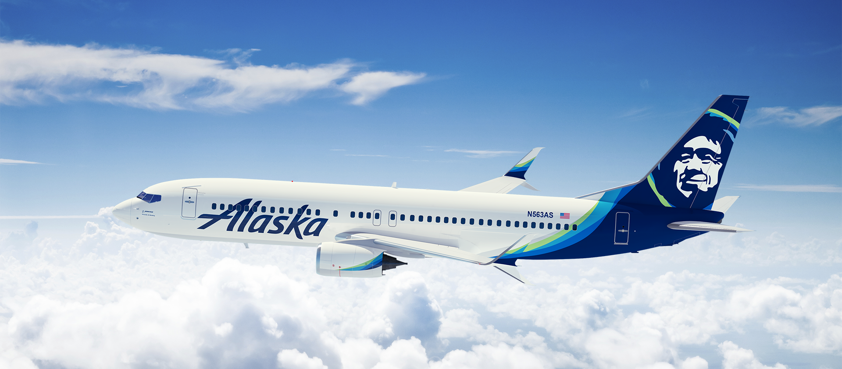
Alaska Airlines
Quarterly Safety Review – Q2 2023

Slide 2
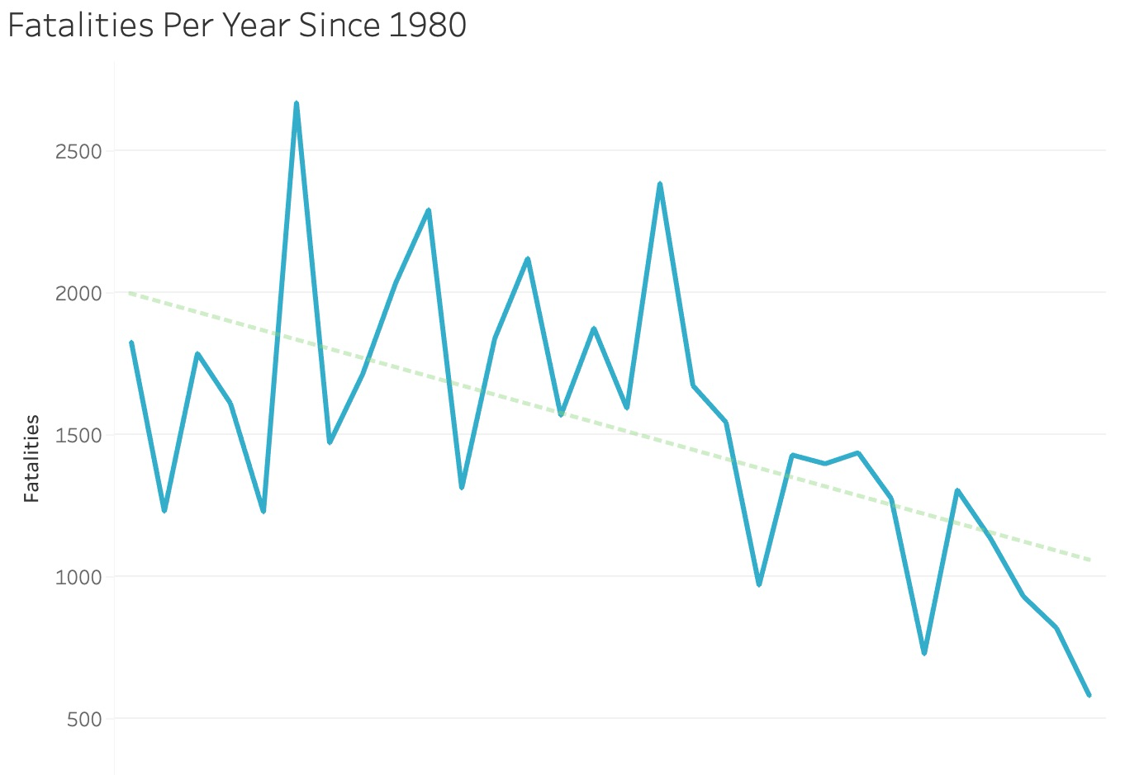
Airplane Crashes & Fatalities
News media has had a recent focus on sensationalizing crash data to convey the idea that crashes are becoming more frequent
Airplane crash fatalities are actually trending downwards, as they have been for decades
Air travel is increasingly becoming a safer travel option for our consumers

Slide 3
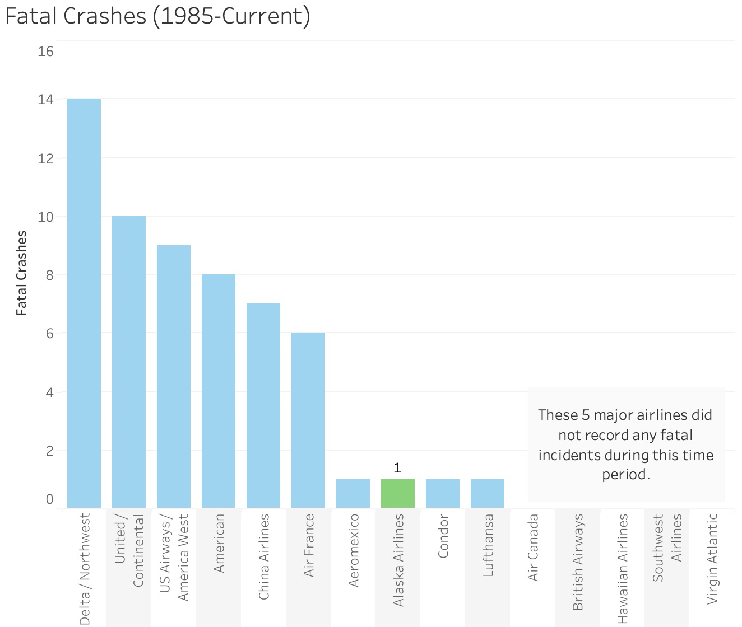
Our Safety Statistics
Our airline has been involved in one fatal crash since 1985
We are one of the safest airlines out of the major US markets

Slide 4
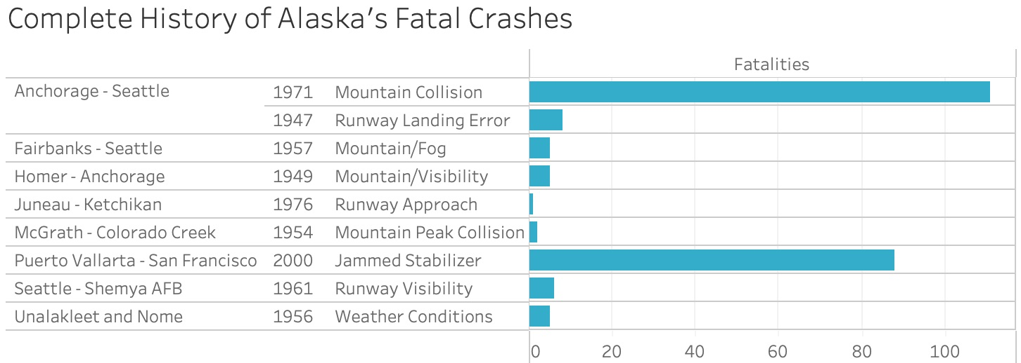
Learning From Our Past
Though we have only experienced one crash in the modern period, there were a few more in our past prior to 1985
Most incidents involve collisions with mountain terrain or poor runway conditions
Modern technology and regulations render the incidence of these types of events to be negligible
Our 2000 crash is the most troubling, as we bypassed company & federal regulations to approve a stabilizer unfit for air travel

Slide 5
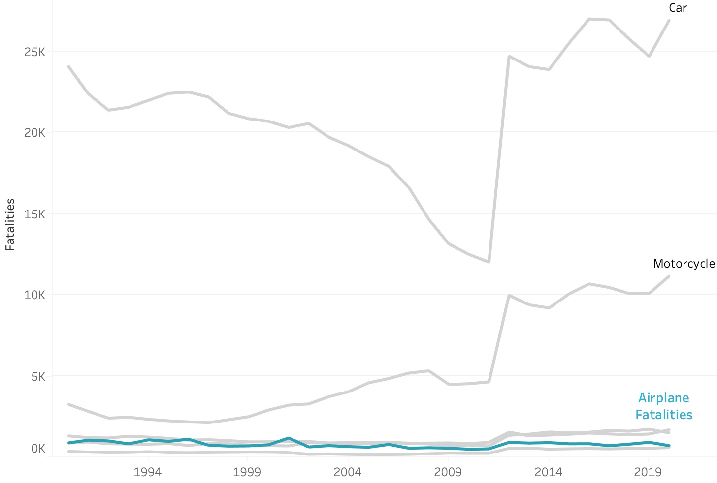
Air Travel: One of The Safest Modes of Transport
Contrary to the dangers presented by the media, air travel is one of the safest ways to travel, resulting in significantly fewer fatalities than traveling by car or motorcycle

Slide 6
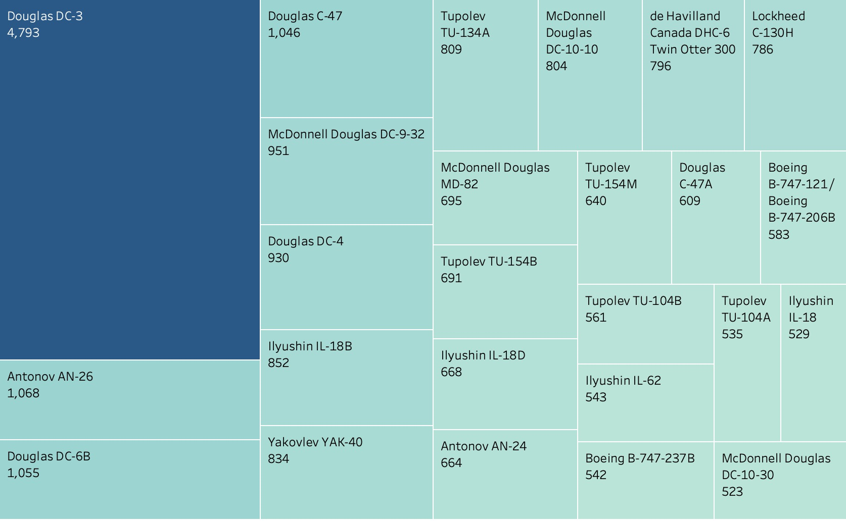
Aircraft Safety
Douglas aircrafts tend to be the most dangerous models, specifically the Douglas DC-3 which has been involved in 4793 civilian casualties

Slide 7
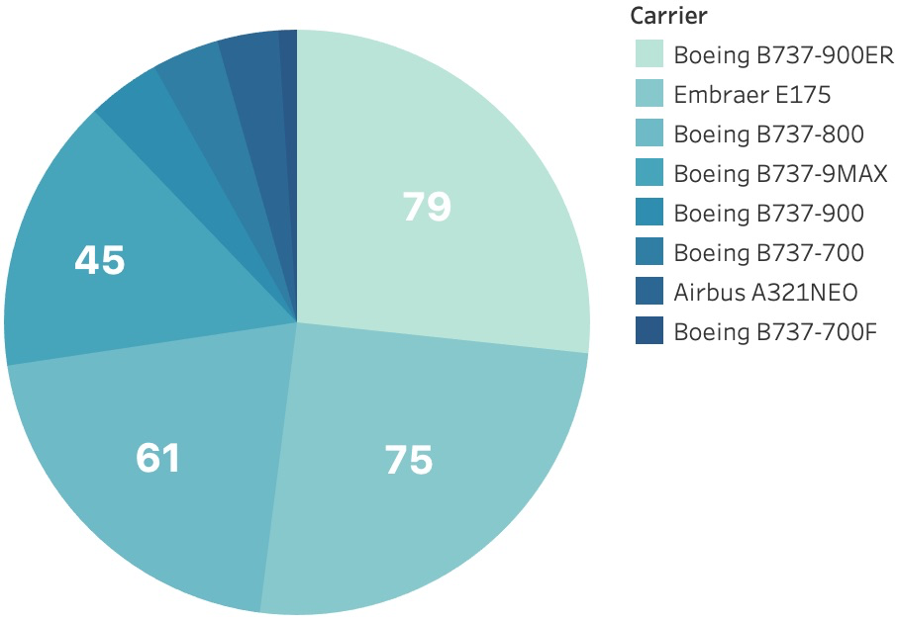
Our Aircraft Fleet
Our aircraft fleet contains 8 different models
These are primarily Boeing-737 models
None of the commercial aircraft we fly are included in the aforementioned list of the most lethal carriers
The McDonnell Douglas model highlighted in the aircraft safety discussion was the vessel involved in our 2000 crash
This model has since been removed from the fleet, as our company strives to present only the safest experience for our consumers

Slide 8
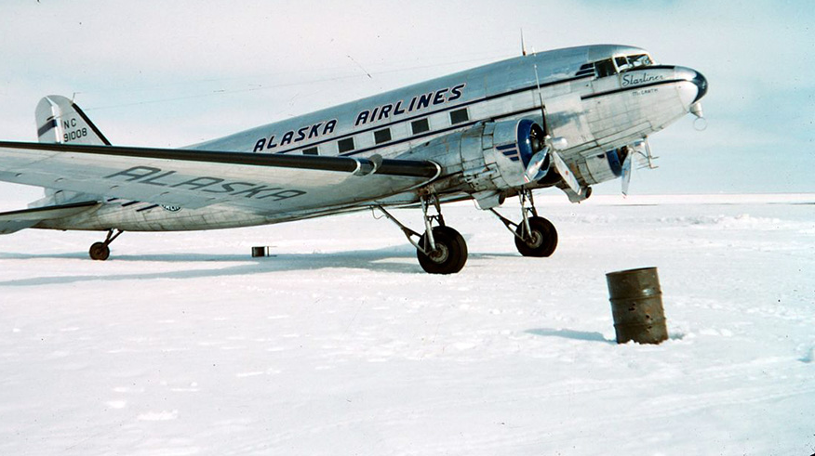
In Conclusion
We have taken many steps in the right direction to improve safety within our fleet over the last decade
The conditions that used to increase risk are now mitigated by modern technological advances
As a result, air travel is one of the safest ways for consumers to get to their destination

Slide 9
References
Alaska Airlines Fleet: https://news.alaskaair.com/current-fleet/
Airline Safety: https://github.com/fivethirtyeight/data/tree/master/airline-safety
Bureau of Transportation Statistics: https://www.bts.gov/content/transportation-fatalities-mode
World Airplane Crash History: https://www.kaggle.com/datasets/saurograndi/airplane-crashes-since-1908

